Slide 1

WAY TO ENTERPRISE
AWS
VTI ACADEMY
Author: duy.nguyenngoc1@vti.com.vn

Slide 2
AmazonMQ Service
Is a managed message broker service that allows migrate to a message broker in the cloud
  SQS, SNS are "cloud-native" services, and they’re using proprietary protocols from AWS
  Traditional applications running from on-premise may use open protocols such as: MQTT, AMQP, STOMP, Openwire, WSS 🡺 When migrating to the cloud, instead of re-engineering the application to use SQS and SNS, you can use Amazon MQ
Amazon MQ doesn’t "scale" as much as SQS / SNS
Amazon MQ has both queue feature (~SQS) and topic features (~SNS)
Support ActiveMQ and RabbitMQ
Price: https://aws.amazon.com/amazon-mq/pricing

Slide 3
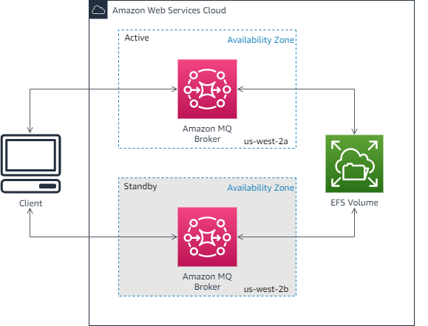
AmazonMQ Service
Support Multi-AZ
Tutorial: https://docs.aws.amazon.com/amazon-mq/latest/developer-guide/welcome.html

Slide 4
AmazonMQ Service
Demo
  https://www.youtube.com/watch?v=q22lTqogYYc
  https://www.youtube.com/watch?v=ibvCmegX0Io

Slide 5
Q & A
Copyright © VTI Academy All Rights Reserved

